Slide 1
Language Models
Hongning Wang
CS@UVa

Slide 2
Two-stage smoothing ^{[Zhai & Lafferty 02]}
Stage-1
-Explain unseen words
-Dirichlet prior (Bayesian)
Stage-2
-Explain noise in query
-2-component mixture
μ
λ
Collection LM
c(w,d)
+μp(w|C)
P(w|d) =
(1-λ)
+ λp(w|U)
|d|
+μ
User background model
Can be approximated by p(w|C)

Slide 3

Estimating λ using EM algorithm ^{[Zhai & Lafferty 02]}
Consider query generation as a mixture over all the relevant documents
Stage-1
Stage-2
μ
λ
d₁
P(w|d₁)
(1-λ)p(w|d₁)+ λp(w|U)
π₁
...
… ...
Query
Q=q₁…q_{m}
Probability of choosing LM $p(w|d_{i})$
π_{N}
λ
μ
d_{N}
P(w|d_{N})
(1-λ)p(w|d_{N})+ λp(w|U)
Estimated in stage-1
Expectation-Maximization (EM) algorithm for estimating $λ$ and ${\left\{π_{i}\right\}}_{i=1}^{N}$

Slide 4
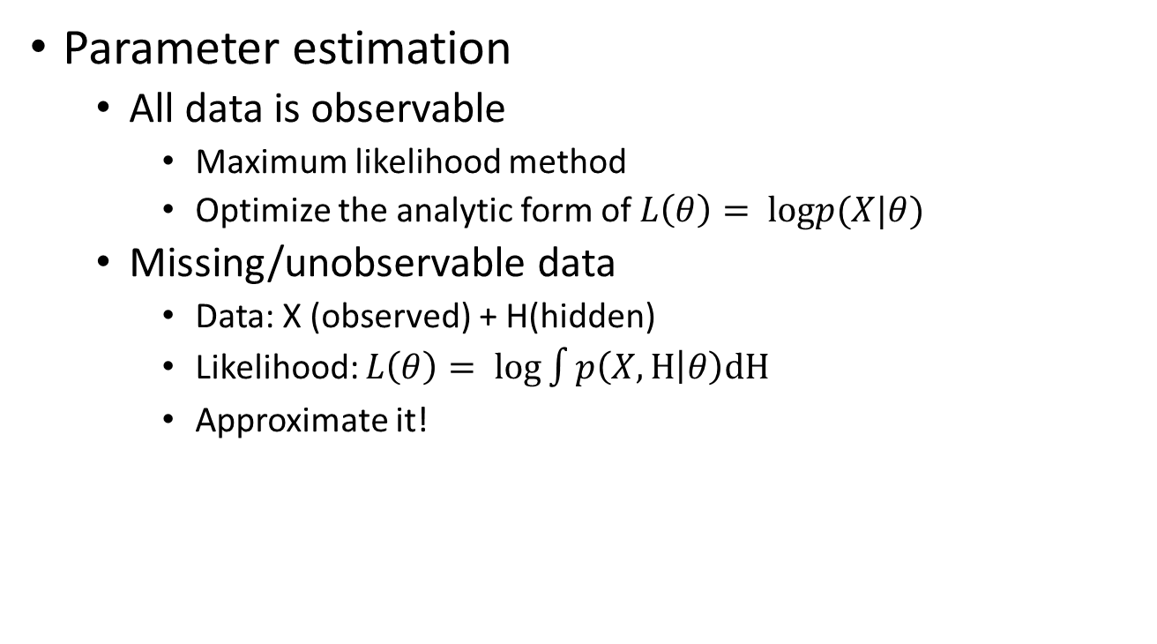
Introduction to EM
Parameter estimation
All data is observable
Maximum likelihood method
Optimize the analytic form of $L\left(θ\right)= logp(X|θ)$
Missing/unobservable data
Data: X (observed) + H(hidden)
Likelihood: $L\left(θ\right)= log\int{p\left(X,H | θ\right)dH}$
Approximate it!
Most of cases are intractable
We have missing date.

Slide 5
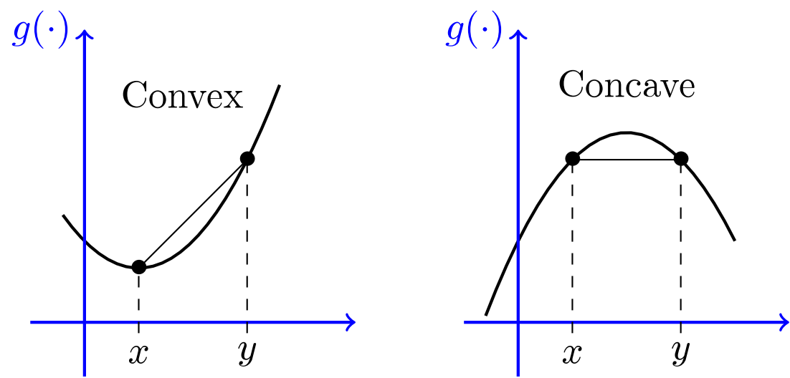
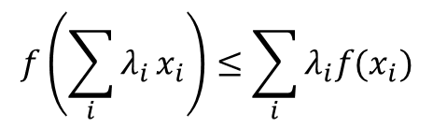


Background knowledge
Jensen's inequality
For any convex function $f(x)$ and positive weights $λ,$
$$f\left(\sum_{i}{λ_{i}}x_{i}\right)≤\sum_{i}{λ_{i}f(x_{i})}$$
$$\sum_{i}{λ_{i}}=1$$

Slide 6
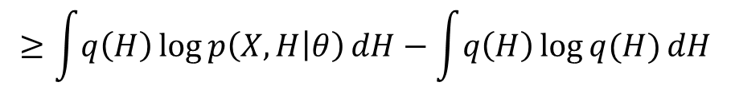




Expectation Maximization
Maximize data likelihood function by pushing the lower bound
$L\left(θ\right)= log\int{p\left(X,H | θ\right)dH}=log\int{\frac{q(H)p\left(X,H | θ\right)}{q(H)}dH}$
Proposal distributions for $q(H)$
Jensen's inequality
$$≥\int{q\left(H\right)\log{p\left(X,H | θ\right)}dH}−\int{q\left(H\right)\log{q(H)}dH}$$
$$f\left(E\left[x\right]\right)≥E[f(x)]$$
Lower bound: easier to compute, many good properties!
Components we need to tune when optimizing $L\left(θ\right)$: $q(H)$ and $θ!$

Slide 7
Intuitive understanding of EM
Data likelihood p(X| θ)
Easier to optimize, guarantee to improve data likelihood
Lower bound
θ

Slide 8

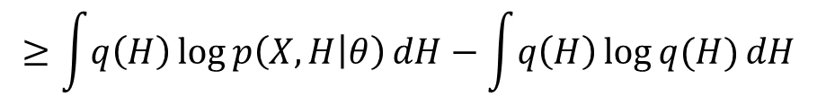


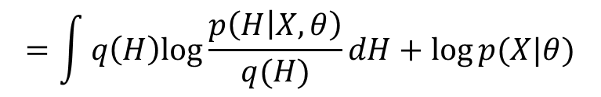
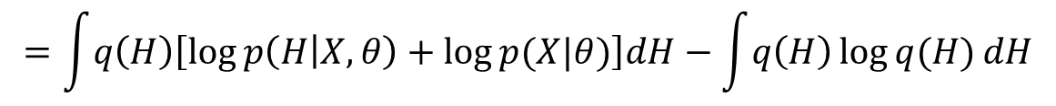

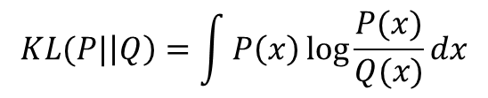
Expectation Maximization (cont)
Optimize the lower bound with respect to $q(H)$
$L\left(θ\right)= log\int{p\left(X,H | θ\right)dH}=log\int{\frac{q(H)p\left(X,H | θ\right)}{q(H)}dH}$
Jensen's inequality
$$≥\int{q\left(H\right)\log{p\left(X,H | θ\right)}dH}−\int{q\left(H\right)\log{q(H)}dH}$$
$$f\left(E\left[x\right]\right)≥E[f(x)]$$
$$=\int{q\left(H\right)\left[\log{p\left(H | X,θ\right)}+\log{p(X|θ)}\right]dH}−\int{q\left(H\right)\log{q(H)}dH}$$
$$=\int{q\left(H\right)log\frac{p\left(H | X,θ\right)}{q(H)}dH}+log⁡p(X|θ)$$
KL-divergence between $q(H)$ and $p\left(H | X,θ\right)$
Constant with respect to $q(H)$
$$KL(P|\left|Q\right)=\int{P\left(x\right)\log{\frac{P(x)}{Q(x)}}dx}$$

Slide 9
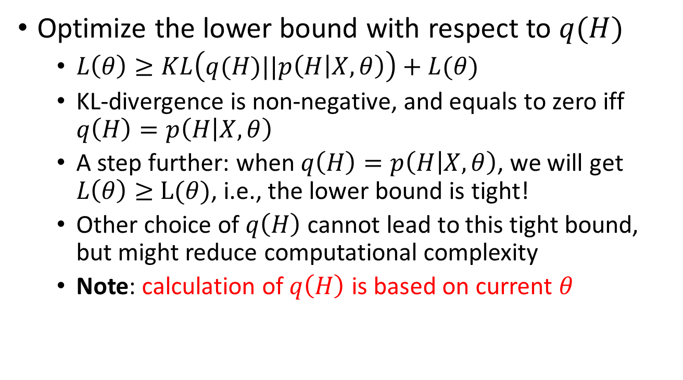
Expectation Maximization (cont)
Optimize the lower bound with respect to $q(H)$
$L\left(θ\right)≥KL\left(q(H)||p\left(H | X,θ\right)\right)+L(θ)$
KL-divergence is non-negative, and equals to zero iff $q\left(H\right)=p\left(H | X,θ\right)$
A step further: when $q\left(H\right)=p\left(H | X,θ\right)$, we will get $L\left(θ\right)≥$ $L(θ)$, i.e., the lower bound is tight!
Other choice of $q\left(H\right)$ cannot lead to this tight bound, but might reduce computational complexity
Note: calculation of $q\left(H\right)$ is based on current $θ$
$L\left(θ\right)≥−KL\left(q(H)||p\left(H | X,θ\right)\right)+L(θ)$

Slide 10

Expectation Maximization (cont)
Optimize the lower bound with respect to $q(H)$
Optimal solution: $q\left(H\right)=p\left(H|X,θ^{t}\right)$
Posterior distribution of $H$ given current model $θ^{t}$

Slide 11

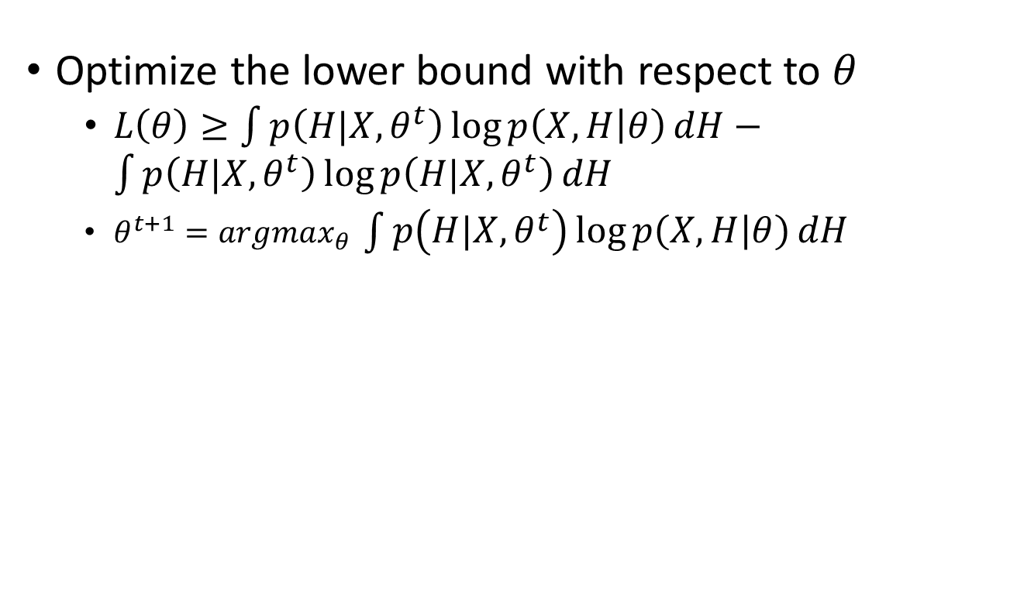

Expectation Maximization (cont)
Optimize the lower bound with respect to $θ$
$L\left(θ\right)≥\int{p\left(H|X,θ^{t}\right)\log{p\left(X,H | θ\right)}dH}−\int{p\left(H|X,θ^{t}\right)\log{p\left(H|X,θ^{t}\right)}dH}$
$θ^{t+1}=argmax_{θ} \int{p\left(H|X,θ^{t}\right)\log{p\left(X,H | θ\right)}dH}$
Constant w.r.t. $θ$
$$=argmax_{θ}E_{H|X,θ^{t}}\left[\log{p(X,H|θ)}\right]$$
Expectation of complete data likelihood

Slide 12
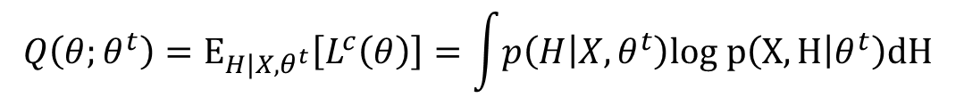
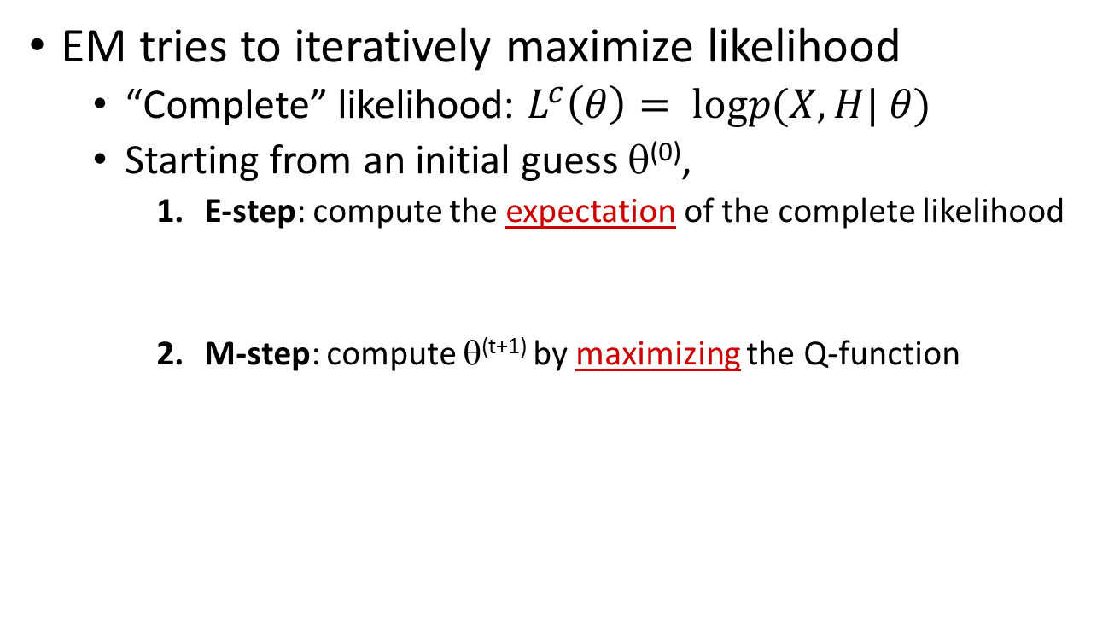

Expectation Maximization
EM tries to iteratively maximize likelihood
“Complete” likelihood: $L^{c}\left(θ\right)= logp(X,H| θ)$
Starting from an initial guess θ⁽⁰⁾,
E-step: compute the expectation of the complete likelihood
M-step: compute θ^{(t+1)} by maximizing the Q-function
$$Q\left(θ;θ^{t}\right)=E_{{H|X,θ}^{t}}\left[L^{c}\left(θ\right)\right]=\int{p\left(H | X,θ^{t}\right)log p\left(X,H | θ^{t}\right)dH }$$
$$θ^{t+1}=argmax_{θ}Q\left(θ;θ^{t}\right)$$
Key step!

Slide 13



Intuitive understanding of EM
S=We have missing date.
Data likelihood p(X| θ)
$$p\left(date | S,θ^{t}\right)=0.1$$
E-step:
$$p\left(data | S,θ^{t}\right)=0.9$$
M-step:
$$p\left(data | θ^{t+1}\right)∝0.9+\sum_{observed}{1}$$
next guess
current guess
Lower bound
(Q function)
θ
E-step = computing the lower bound
M-step = maximizing the lower bound

Slide 14

Convergence guarantee
Proof of EM
$$\log{p\left(X | θ\right)}=\log{p\left(H,X | θ\right)−\log{p(H|X,θ)}}$$
Taking expectation with respect to $p(H|X,θ^{t})$ of both sides:
$$\log{p\left(X | θ\right)}=\int{p(H|X,θ^{t})}\log{p\left(H,X | θ\right)dH}−\int{p(H|X,θ^{t})}\log{p(H|X,θ)dH}$$
$$\log{p\left(X | θ\right)}=Q\left(θ;θ^{t}\right)+H(θ;θ^{t})$$
Cross-entropy
Then the change of log data likelihood between EM iteration is:
$$\log{p\left(X | θ\right)−\log{p(X|θ^{t})}}=Q\left(θ;θ^{t}\right)+H\left(θ;θ^{t}\right)−Q\left(θ^{t};θ^{t}\right)−H(θ^{t};θ^{t})$$
By Jensen’s inequality, we know $H\left(θ;θ^{t}\right)≥H\left(θ^{t};θ^{t}\right)$, that means
$$\log{p\left(X | θ\right)−\log{p(X|θ^{t})}}≥Q\left(θ;θ^{t}\right)−Q\left(θ^{t};θ^{t}\right)≥0$$
M-step guarantee this

Slide 15
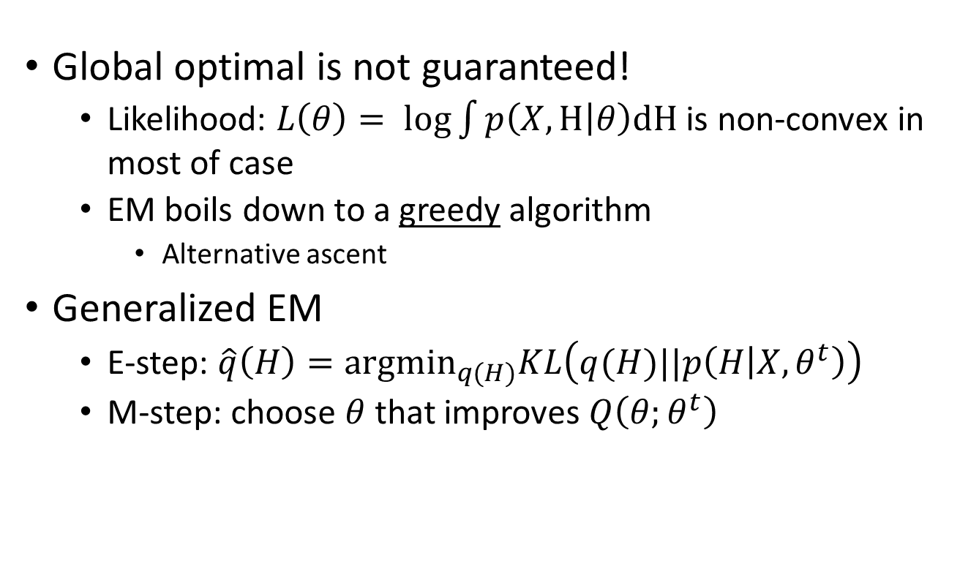
What is not guaranteed
Global optimal is not guaranteed!
Likelihood: $L\left(θ\right)= log\int{p\left(X,H | θ\right)dH}$ is non-convex in most of case
EM boils down to a greedy algorithm
Alternative ascent
Generalized EM
E-step: $\hat{q}\left(H\right)={argmin}_{q(H)}KL\left(q(H)||p\left(H | X,θ^{t}\right)\right)$
M-step: choose $θ$ that improves $Q\left(θ;θ^{t}\right)$

Slide 16
Estimating λ using Mixture Model ^{[Zhai & Lafferty 02]}
Stage-1
Stage-2
Origin of the query term is unknown, i.e., from user background or topic?
μ
λ
d₁
P(w|d₁)
(1-λ)p(w|d₁)+ λp(w|U)
π₁
...
… ...
Query
Q=q₁…q_{m}
π_{N}
λ
μ
d_{N}
P(w|d_{N})
(1-λ)p(w|d_{N})+ λp(w|U)
Estimated in stage-1
Expectation-Maximization (EM) algorithm for estimating $λ$ and ${\left\{π_{i}\right\}}_{i=1}^{N}$

Slide 17
Variants of basic LM approach
Different smoothing strategies
Hidden Markov Models (essentially linear interpolation) ^{[Miller et al. 99]}
Smoothing with an IDF-like reference model ^{[Hiemstra & Kraaij 99]}
Performance tends to be similar to the basic LM approach
Many other possibilities for smoothing ^{[Chen & Goodman 98]}
Different priors
Link information as prior leads to significant improvement of Web entry page retrieval performance ^{[Kraaij et al. 02]}
Time as prior ^{[Li & Croft 03]}
PageRank as prior ^{[Kurland & Lee 05]}
Passage retrieval ^{[Liu & Croft 02]}

Slide 18
Improving language models
Capturing limited dependencies
Bigrams/Trigrams ^{[Song & Croft 99]}
Grammatical dependency [Nallapati & Allan 02, Srikanth & Srihari 03, Gao et al. 04]
Generally insignificant improvement as compared with other extensions such as feedback
Full Bayesian query likelihood ^{[Zaragoza et al. 03]}
Performance similar to the basic LM approach
Translation model for p(Q|D,R) [Berger & Lafferty 99, Jin et al. 02,Cao et al. 05]
Address polesemy and synonyms
Improves over the basic LM methods, but computationally expensive
Cluster-based smoothing/scoring [Liu & Croft 04, Kurland & Lee 04,Tao et al. 06]
Improves over the basic LM, but computationally expensive
Parsimonious LMs ^{[Hiemstra et al. 04]}
Using a mixture model to “factor out” non-discriminative words

Slide 19
A unified framework for IR: Risk Minimization
Long-standing IR Challenges
Improve IR theory
Develop theoretically sound and empirically effective models
Go beyond the limited traditional notion of relevance (independent, topical relevance)
Improve IR practice
Optimize retrieval parameters automatically
Language models are promising tools …
How can we systematically exploit LMs in IR?
Can LMs offer anything hard/impossible to achieve in traditional IR?

Slide 20
Idea 1: Retrieval as decision-making (A more general notion of relevance)
Given a query,
- Which documents should be selected? (D)
- How should these docs be presented to the user? (π)
Choose: (D,π)
?
Unordered subset
?
…
Query
Ranked list
1
2
3
4
?
Clustering

Slide 21
Idea 2: Systematic language modeling
QUERY MODELING
Query
Query
Language Model
USER MODELING
?
Retrieval Decision:
Loss Function
User
Documents
Document
Language Models
DOC MODELING

Slide 22
Generative model of document & query ^{[Lafferty & Zhai 01b]}
User
U
q
Query
Partially
observed
observed
R
S
d
Document
Source
inferred

Slide 23
Applying Bayesian Decision Theory [Lafferty & Zhai 01b, Zhai 02, Zhai & Lafferty 06]
Loss
L
L
L
query q
user U
θ_{q}
Choice: (D₁,π₁)
θ₁
Choice: (D₂,π₂)
...
doc set C
source S
Choice: (D_{n},π_{n})
θ_{N}
loss
hidden
observed
RISK MINIMIZATION
Bayes risk for choice (D, π)

Slide 24
Special cases
Set-based models (choose D)
Ranking models (choose π)
Independent loss
Relevance-based loss
Distance-based loss
Dependent loss
Maximum Margin Relevance loss
Maximal Diverse Relevance loss
Boolean model
Probabilistic relevance model
Generative Relevance Theory
Vector-space Model
Two-stage LM
KL-divergence model
Subtopic retrieval model

Slide 25

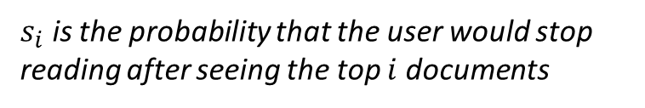
Optimal ranking for independent loss
Decision space = {rankings}
Sequential browsing
Independent loss
$s_{i}$ is the probability that the user would stop reading after seeing the top $i$ documents
Independent risk
= independent scoring
“Risk ranking principle”
[Zhai 02]

Slide 26
Automatic parameter tuning
Retrieval parameters are needed to
model different user preferences
customize a retrieval model to specific queries and documents
Retrieval parameters in traditional models
EXTERNAL to the model, hard to interpret
Parameters are introduced heuristically to implement “intuition”
No principles to quantify them, must set empirically through many experiments
Still no guarantee for new queries/documents
Language models make it possible to estimate parameters…

Slide 27
Parameter setting in risk minimization
Estimate
Query model parameters
Query
Query
Language Model
Set
User model parameters
User
Loss Function
Estimate
Doc model parameters
Documents
Document
Language Models

Slide 28
Summary of risk minimization
Risk minimization is a general probabilistic retrieval framework
Retrieval as a decision problem (=risk min.)
Separate/flexible language models for queries and docs
Advantages
A unified framework for existing models
Automatic parameter tuning due to LMs
Allows for modeling complex retrieval tasks
Lots of potential for exploring LMs…

Slide 29
What you should know
EM algorithm
Risk minimization framework

